Slide 1

Infoproducts

Slide 2

What are infoproducts?
They are digital products used to transform your or your company’s experience and knowledge into training products that are distributed through the internet.

Slide 3

How can you use them?
Internal training for your company
To have passive income through the sale of online courses
To accompany physical products

Slide 4

What problem do they solve?
Internal learning
Solve initial training problems for new members
Updates of protocols and procedures. Thus structuring information
Specific training for each role in the company

Slide 5

What problem do they solve?
Sale of online courses
(Almost) free distribution
Easy to create
100% passive income

Slide 6


What problem do they solve?
Accompany physical products
Give more value to products
Teach your buyers how to use products. i.e. thermomix
Sell ​​your product

Slide 7

Who is it for?
Video courses are ideal for entrepreneurs who feel comfortable in front of a camera, who want to enhance their personal brand and who intend to teach practical knowledge.
They are also for those producers who want to position their course in the premium segment, selling it at a high price, and who have good knowledge of digital marketing

Slide 8
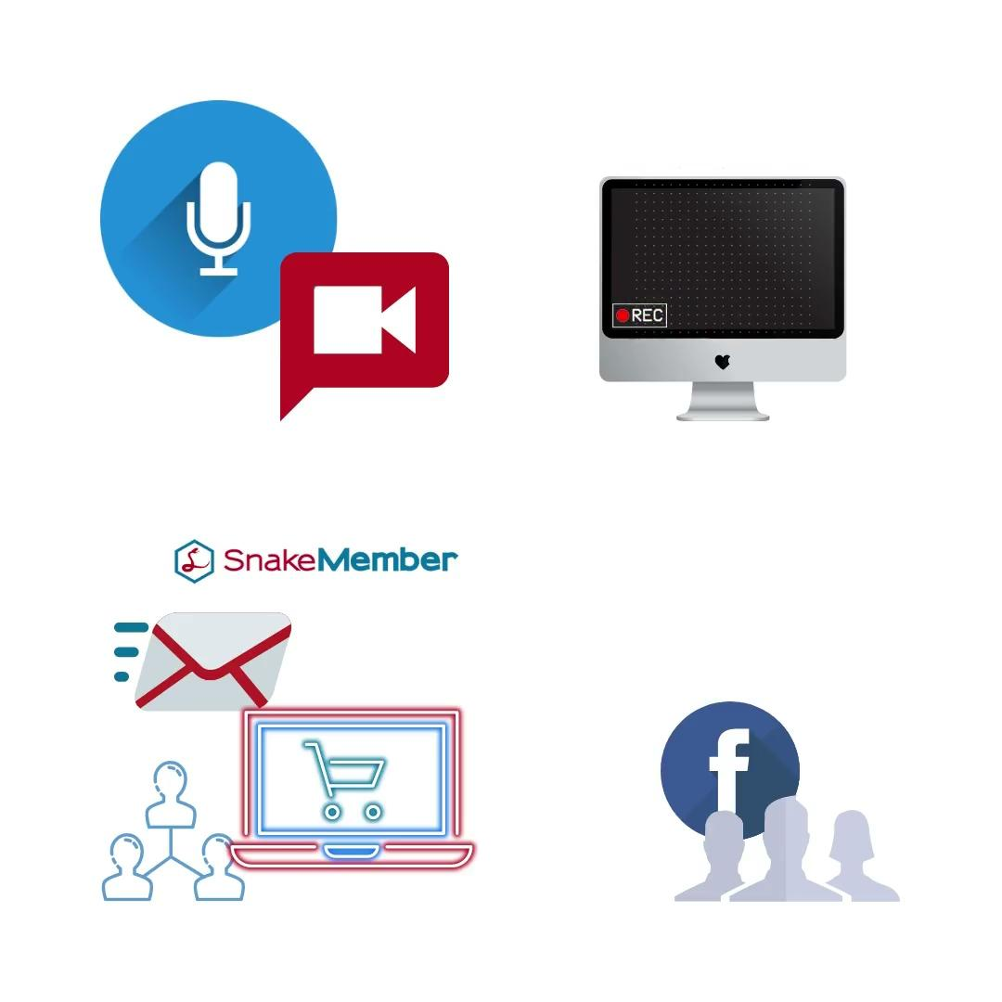
What does it require?
Depending on the format you use, you will need a microphone (offering good audio quality is essential) and a device to record yourself (you can simply use your mobile camera) or a program that allows you to capture the screen of your computer, such as ScreenFlow, Camtasia or Zoom.
If you are going to appear on screen, consider also buying lighting equipment.
An All-in-one tool like Snake Member to manage:
Email marketing
Sales Online
Member Area for Online Courses
You will also need a platform to create a community and interact with your learners, such as a private Facebook group.

Slide 9

EXAMPLE
Rich Coach University
Sell at once.
Or divided into 5 parts
https://www.youhavegotthepower.com/

Slide 10

Payment Types
You can sell courses in full, with 1 single payment
Courses with monthly payments, for as little as 2 months
Courses that are on a typical membership site, with a monthly access fee, for Premium content

Slide 11

For more information visit:
www.snakemember.com/gothepower
If you like the presentation and you want to know more, request a free session now to see how you can use info-products for your business.
www.snakemember.com/gothepower

